Slide 1
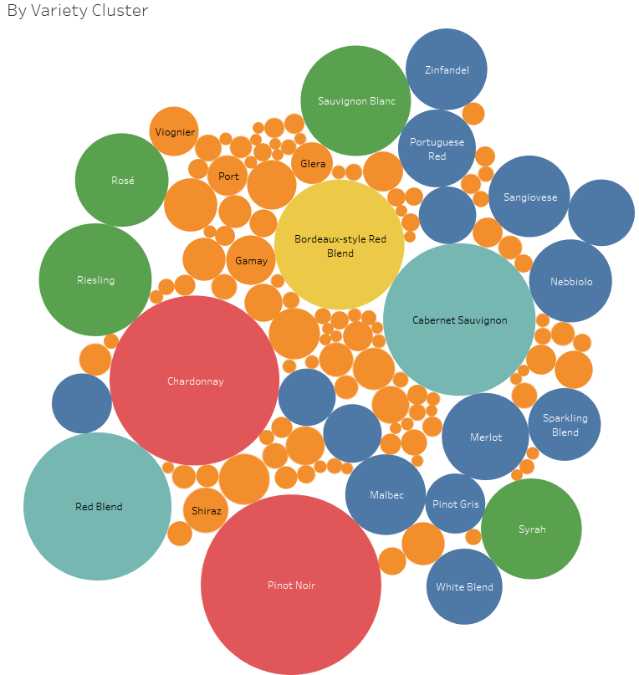
Wine Reviews Analysis and Visualization
March 2018
Michael DeGrado
Regis University
Data Science Practicum 1 (2018S8W1)

Slide 2
Objective Analysis of wine tasting data
Introduction
Project motivation was to develop text analytics to understand a wine tasters description of a wine and re-use that code for other text projects like surveys.
I am Database Technology student at Regis and an IT Manager by profession.
Deeper understanding the wine tasters description/review
Do low/high scores have correlations to certain words in tasters description?
Can that be quantified using a Naïve Bayes feature classification model in Python that lists most informative features?
Can we understanding relationship of wine taster description and points?
Python Machine Learning wine score/point prediction
Exploratory data analysis
Learning and developing reports in Tableau to explore the wine data set
Learning and developing word cloud in R to understand descriptions

Slide 3
Approach What tools were used for analyzing the wine data?
Exploratory data analysis tools used
Excel
Tableau
R – Word Clouds
Python plots
Modeling and Machine Learning - Python
Naïve Bayes feature classification model
Logistic Regression prediction
Naïve Bayes BernoulliNB prediction
Plotting Cross-Validated Predictions

Slide 4
Overview of Wine Data from Kaggle What were the attributes of the wine data?
https://www.kaggle.com/zynicide/wine-reviews
The data was scraped from WineEnthusiast during the week of June 15th, 2017.
The data consists of 148k wine reviews consisting of 10 fields:
Points: the number of points WineEnthusiast rated the wine on a scale of 1-100 (though they say they only post reviews for wines that score >=80)
Title: the title of the wine review, which often contains the vintage if you're interested in extracting that feature
Variety: the type of grapes used to make the wine (ie Pinot Noir)
Description: a few sentences from a sommelier describing the wine's taste, smell, look, feel, etc.
Country: the country that the wine is from
Province: the province or state that the wine is from
Region 1: the wine growing area in a province or state (ie Napa)
Region 2: sometimes there are more specific regions specified within a wine growing area (ie Rutherford inside the Napa Valley), but this value can sometimes be blank
Winery: the winery that made the wine
Designation: the vineyard within the winery where the grapes that made the wine are from
Price: the cost for a bottle of the wine
Taster Name: name of the person who tasted and reviewed the wine
Taster Twitter Handle: Twitter handle for the person who tasted and reviewed the wine
Green color indicates usage of this item in the analysis

Slide 5
Data, Data cleaning and EDA Conclusion
Examples data issues, analysis and mitigations
Input | Notes
Data Cleansing, Data and Analysis issues State of data and cleanup activity | EDA idenfied that Roger Voss and Michael Schachner tastings combined are over 40% of the tastings and could bias the results of the analysis. df = df.dropna(subset=['description']) # code used to drop wine tastings that had no scores associated.
Data imbalance check and implementation, augmentation | Data had many special characters that had to be handled with data cleansing. Examples like: Bodega Carmen RodrÃ­guez and BergstrÃ¶m
Duplicates removed | Data had duplications that had to be filtered out Original input file was 150k, reduced to 130k records.

Slide 6
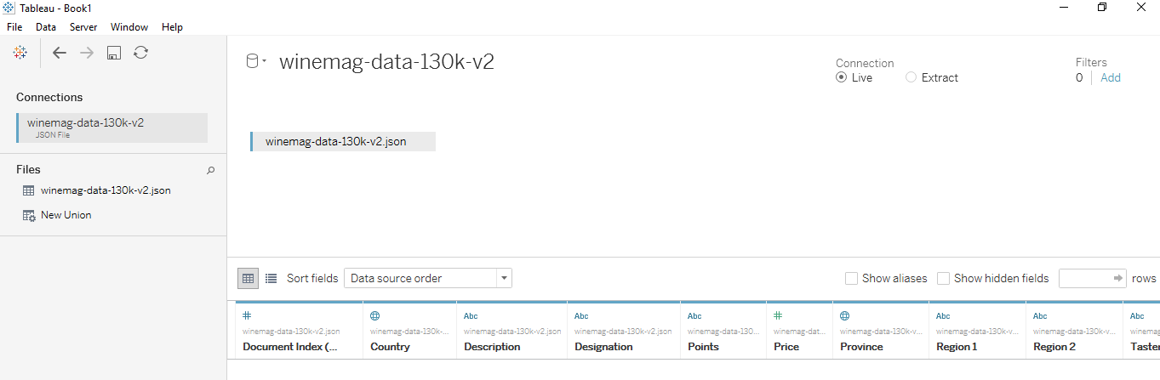
Tableau data retrieval What was technique used to get data into Tableau?
JSON source was available and easily imported into Tableau.

Slide 7
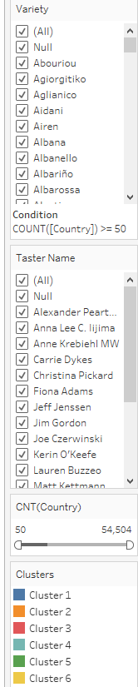
Tableau Wine Variety by Cluster What were the varieties of wine?
This visualization was exploring how to use the Analytics tab that is next to the data tab within Tableau. Also experimented with different types of filters.

Slide 8
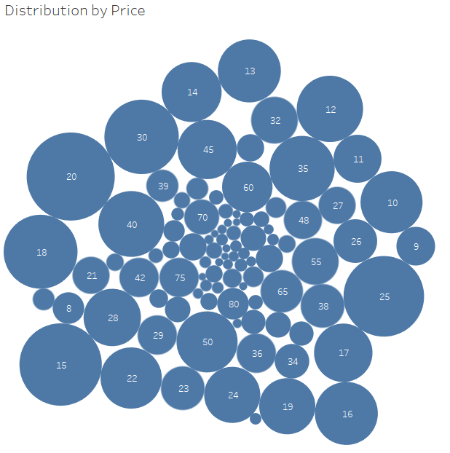
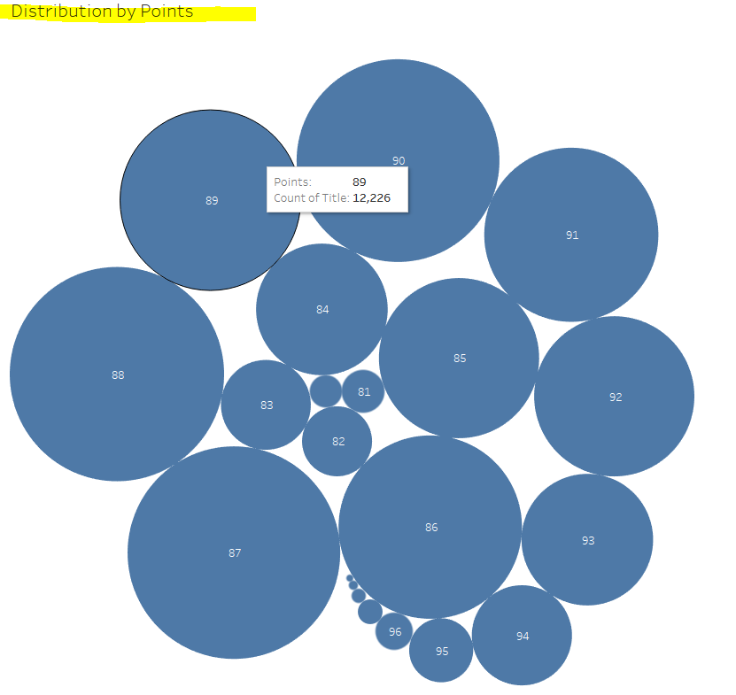
Tableau Wine Distribution by Points and Price What are the groupings of wine by points and price?
Points are from 80 to 100 but fall mostly into 10 scores.
Prices vary much more than wine points

Slide 9
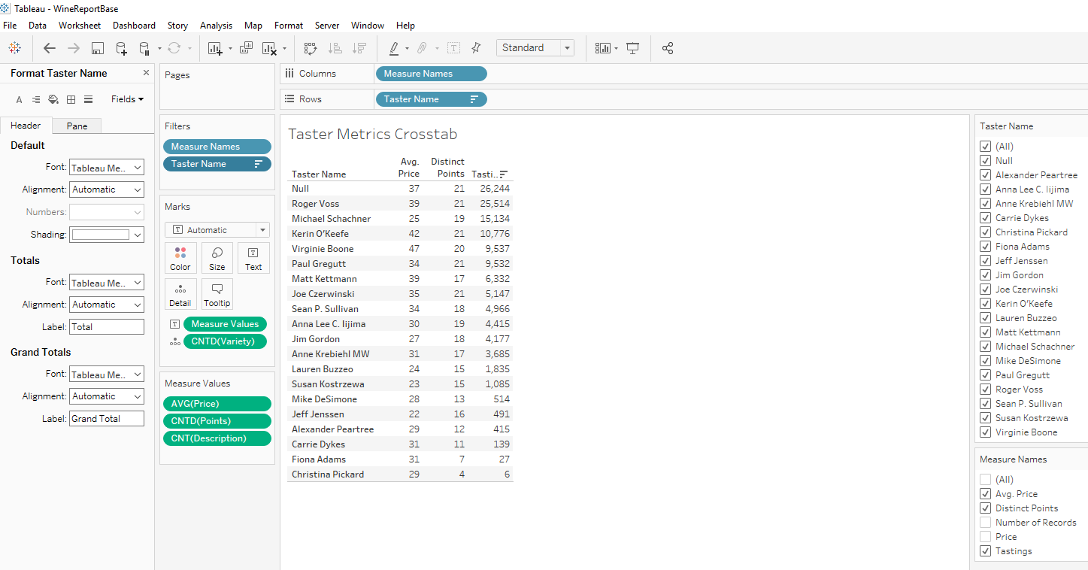
Tableau Taster Metrics What metrics were associated to specific taster?
This report was developed as part of the exploratory data analysis phase, but also to learn more about Tableau. Filters added to right so more analysis can be done on tasters.
Roger Voss and Michael Schachner tastings combined are over 40% of the tastings and could bias the results of the analysis

Slide 10
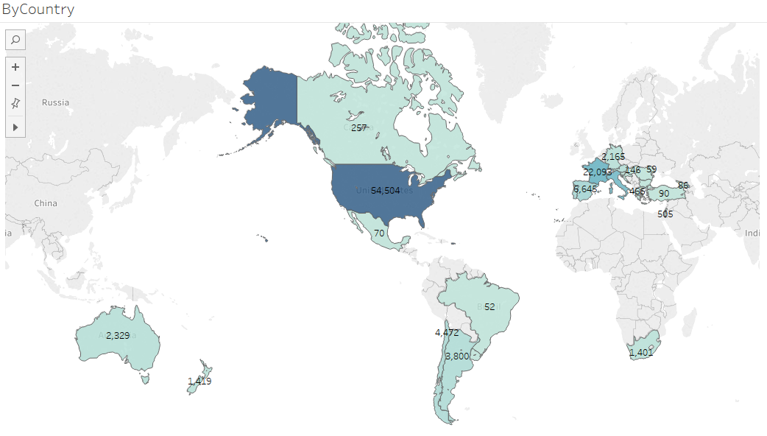
Tableau Wine Tasted by Country
Which countries produced the wines tasted?
Map is using longitude and latitude provided in the data.
The USA has the most wines produced for this set of wine data.

Slide 11
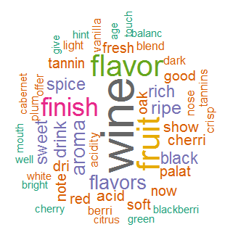
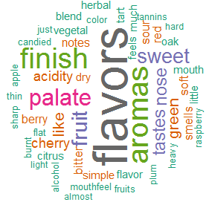
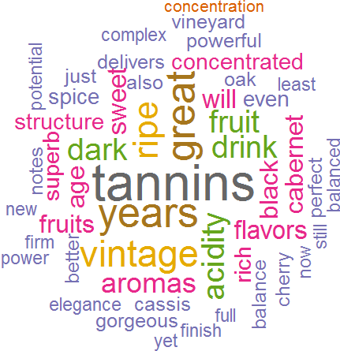
Word Clouds with R What words are associated with the all the wines, the worst and best scored wines?
All wines | Worst 80 & 81 point wines | Best 99 points and up wine
Lower pointed wines have some words like bitter, sour, candied, flat, heavy that might correlate to a lower point score.
The words flavor, finish and fruit stand out in the overall wine cloud.
The words flavors, aromas and finish stand out in the lower pointed wines
The words tannins, years and vintage stand out in the higher pointed wines

Slide 12
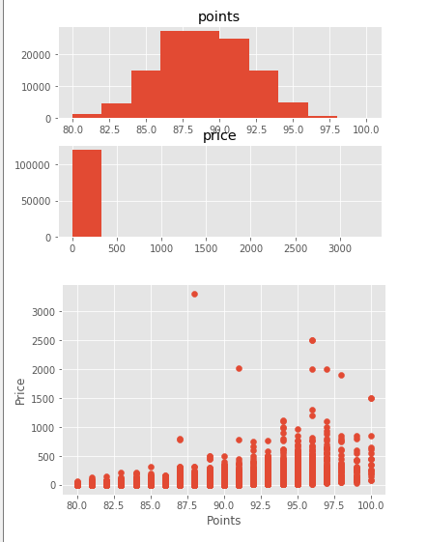
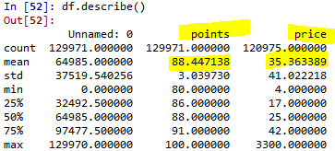
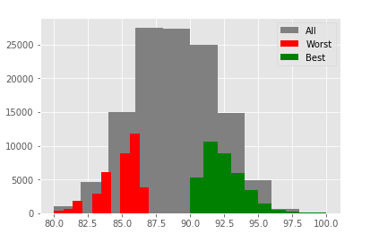
Data plots with Python Distribution by points, price and setting up the scoring breaks for informative features
Points distribution plot
Price distribution
Most wines under 300$
Clean data set shows 129k reviews with a mean score of 88.4 and mean price of 35.36
Price/Point
Scatter shows as price increases a possible correlation in point score
Prepping data for classifier model we setup the best and worst wines according to wine point scores. 30% from lower scoring ‘Worst’ wines and 30% from higher scoring

Slide 13
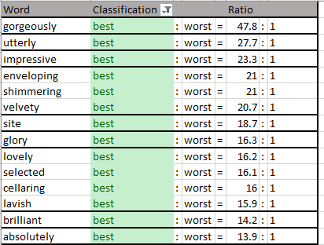
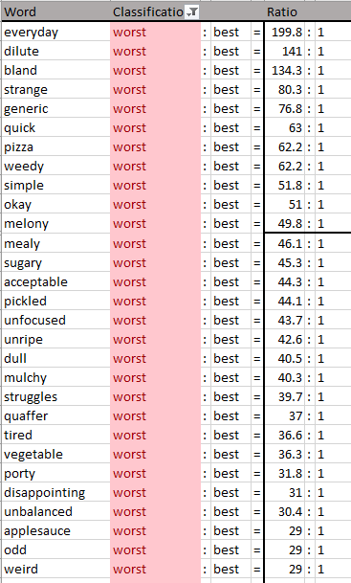
Python Naïve Bayes classifier How do the words used in the wine tasting correlate to the wine point score using most informative features?
Higher ratio negative words like dilute, bland, strange, generic, weedy, simple show up in the reviews for the lower scoring wines.
Ratio (best:worst) calculates how often the word is used in the best wine point score reviews compared to the worst wine point score reviews
The word ‘gorgeously’ is 47.8 times more likely to occur in the wine review of a high scoring ‘best’ wine over a low scoring ‘worst’ wine.
The word ‘everyday’ is 199.8 times more likely to occur in the wine review of a low scoring ‘worst’ wine over a high scoring ‘best’ wine.
Higher ratio positive words like gorgeously, utterly and impressive show in the higher scoring ‘best’ wines

Slide 14
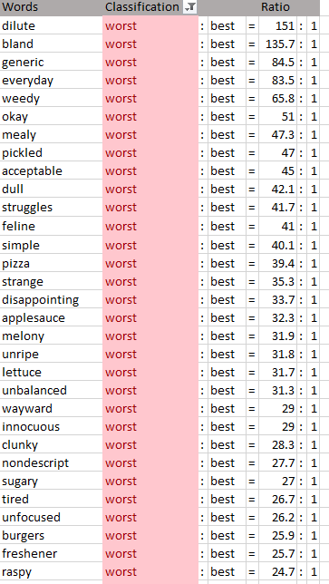
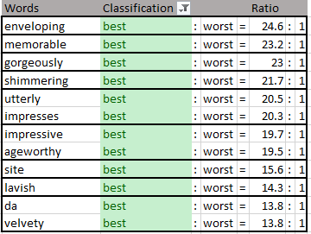
Python Naïve Bayes classifier 2nd run with changes How will the model react to changing input parameters?
Higher ratio negative words like dilute, bland, generic, weedy, simple show up again with the changes in the reviews for the lower scoring wines.
Second run of model parameters switched to top 30% of scored wines ‘best’ and lowest 30% ‘worst’
Changed feature words from 3000 to 4000
The word ‘gorgeously’ now is 23 times more likely to occur in the wine review of a high scoring ‘best’ wine over a low scoring ‘worst’ wine.
The word ‘everyday’ is now 83.5 times more likely to occur in the wine review of a low scoring ‘worst’ wine over a high scoring ‘best’ wine.
Higher ratio positive words like gorgeously, utterly and impressive show in the higher scoring ‘best’ wines

Slide 15
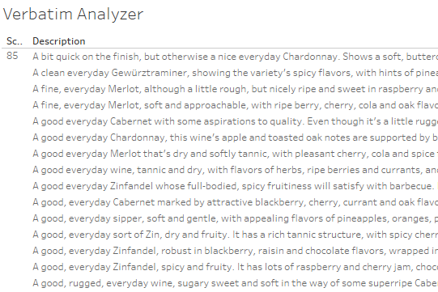
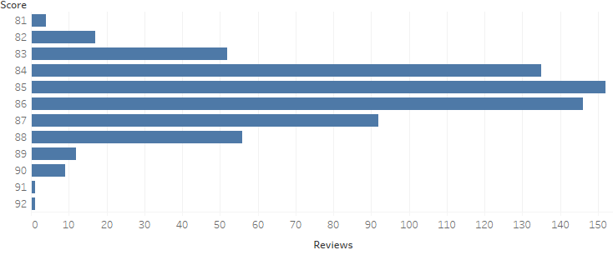
Naïve Bayes follow up Do the actual reviews show the words in the context displayed by the model?
The word ‘everyday’ appears 83.5 to 199.8 more times in the worst wine reviews according to the classifier, is this word informative if we look at samples of the worst wine reviews?
Reading the reviews suggests that the usage of ‘everyday’ in the wine review is indicating that the wine is good vs. excellent.
Also the graph displays that when the word ‘everyday’ is used in the reviews the majority of the scores are in the 85 point category, 5 points away from lowest rating and 3.4 points lower than the mean score 88.4.
Filter applied to reviews with word ‘everyday’.

Slide 16
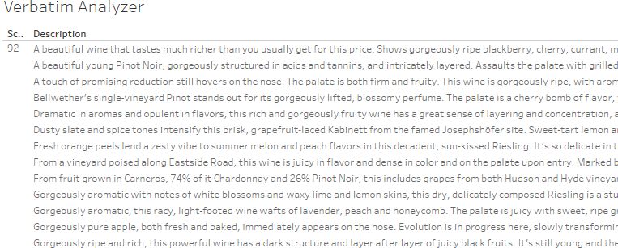
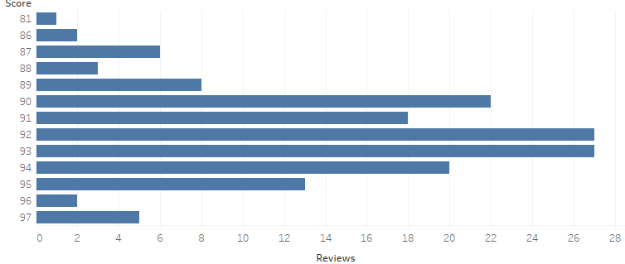
Naïve Bayes follow up Do the actual reviews show the words in the context displayed by the model?
The word ‘gorgeously’ appears 23 to 47 more times in the best wine reviews according to the classifier, is this word informative if we look at samples of the worst wine reviews?
Also the graph displays that when the word ‘gorgeously’ is used in the reviews the majority of the scores are in the 92 and 93 point category, 12 points higher than lowest rating possible. Also 7 points higher than the mean of 88.4.
Filter applied to reviews with word ‘gorgeously’.

Slide 17
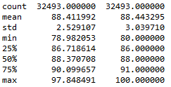
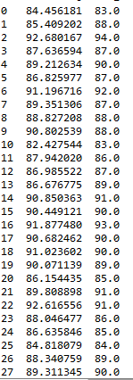
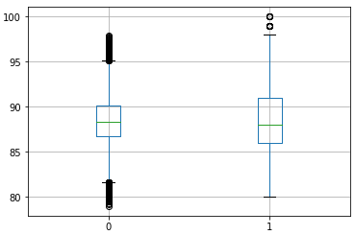
Linear Model Wine description predicting points using Ridge Regression
Describing test results prediction, actual points
Input | Notes
from sklearn import linear_model | Linear least squares with l2 regularization.
from sklearn.feature_extraction.text import TfidfVectorizer | Converts a collection of raw documents to a matrix of TF-IDF features.
from sklearn.metrics import r2_score | Model r2_score 68% R^2 (coefficient of determination) regression score function. Best possible score is 1.0
Training/Test | 75%/25%
Model looks at wine descriptions | Model predicts wine points
Examples test results prediction, actual points

Slide 18
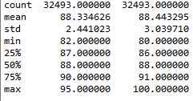

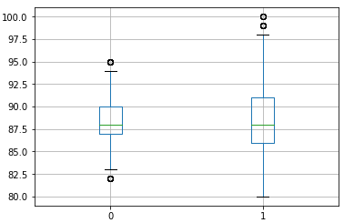
Naïve Bayes Model Description predicting points using BernoulliNB
Describing test results prediction, actual points
Input | Notes
sklearn.naive_bayes import BernoulliNB | Naive Bayes classifier for multivariate Bernoulli models
from sklearn.feature_extraction.text import TfidfVectorizer | Converts a collection of raw documents to a matrix of TF-IDF features.
Training/Test | 75%/25%
Model looks at wine descriptions | Model predicts wine points
Examples test results prediction, actual points

Slide 19
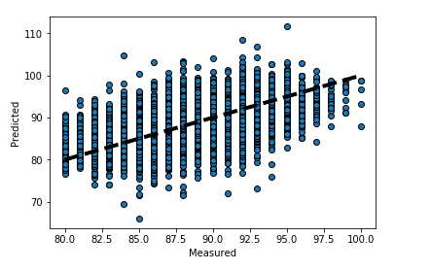
Plotting Cross-Validated Predictions
Plotting example
Input | Notes
sklearn.model_selection import cross_val_predict function. | This example shows how to use cross_val_predict to visualize prediction errors.

Slide 20
Analysis Results, Conclusion and Discussions
What was learned and what are next steps
Input | Findings
Analysis results | Words in tasters descriptions appear to correlate to wine score in many cases Descriptions can be used to predict scores, more model research/tuning needed Exploratory Data Analysis with Tableau and Python were both effective in understanding and visualizing the wine data
Next steps | More exploring with modeling, modeling optimization and scoring. Huge leap forward for me as my Python skills increased from none to beginner Experiment more with model variables, scenarios and results.
My Learning of Python Machine learning and Modeling | First experience with Python outside of a Regis class that had lab examples Learned through practice and was stuck many times Converting numpy series and arrays to a data frame to analyze models output.

Slide 21
Sources Useful links and sources
Description | Link
Data source for wine data | https://www.kaggle.com/zynicide/wine-reviews
Naïve Bayes classifier Tutorial | https://pythonprogramming.net/naive-bayes-classifier-nltk-tutorial/
Sklearn – Logistics and Linear Model | http://scikit-learn.org/
Applied logistic regression, 3rd Edition | Hosmer Jr, D. W., Lemeshow, S., & Sturdivant, R. X. (2013). Applied logistic regression (Vol. 398). John Wiley & Sons.

Slide 22
category | criteria | max pt
Q | Problem Source (higher points if it requires more effort to get data and define problems) - create own problem and data, from company/work, from Kaggle or similar | 5
Q | Defining Problems effort - extra effort defining problems and analysis milestones (+1) | 5
Q | Problem difficulty level | 5
Q | Data collection effort - special tools, multiple source, scraping | 5
Q | Data difficulty level - multi-dtype, manual table join, missing data, wrong labels, messy data | 5
Q | Data cleaning effort | 5
Q | Data inspection effort (initial analysis) | 5
Q | Feature selection/ feature engineering - no-feature selection mentioned (ok), feature selection by intuition (more), feature selection by machine learning (most) | 5
Q | Major tools used - (more) for tools requiring coding effort such as Python and R, (ok) for GUI-based tools such as Tableau | 5
Q | Use of packages/libraries | 5
Q | Use of Machine Learning methods | 5
Q | Effort using analysis methods (how deeply optimize) | 5
Q | Scientific questions and select analysis methods | 5
Q | Data imbalance check and implementation, augmentation | 5
Q | Problem solving & Learning new things on their own | 5
Q | Project Time management | 5
P | Presentation overall quality (Clear explanation & organized) | 10
P | Use visualization and Explain meaning of visualization | 5
P | Explain concepts of methods | 5
P | Presentation time management | 5
G | Overall tidiness, Code organized and commented | 5
G | Project summary - better if summary is on landing page or easy to find. - include visualization visible on the page | 10
B | Communication, progress report | 10
category | description | max pt
Q | Project quality | 80
P | Presentation | 25
G | Git/Blog | 15
B | Bonus | 10
 | Total | 130

